Slide 1
Module-5
DATA ANALYSIS
Basic probability distributions – Normal distribution – Binominal and Poisson distributions – Weibull and exponential distributions; Sampling: types - size, Sampling tests: T-test – F-test – χ2 test; Modelling – validation and verification; Simulation – techniques; ANOVA; Correlation analyses: Pearson and Spearman Correlations; Regression, classification and cluster analyses; Factor analysis; Discriminant analysis; Uncertainty and error analyses; Machine learning: supervised and unsupervised – examples and case studies.

Slide 2
Probability distributions
Probability distributions describe the likelihood of different outcomes in random events. Below are some of the most commonly used basic probability distributions, divided into two types: discrete and continuous.

Slide 3
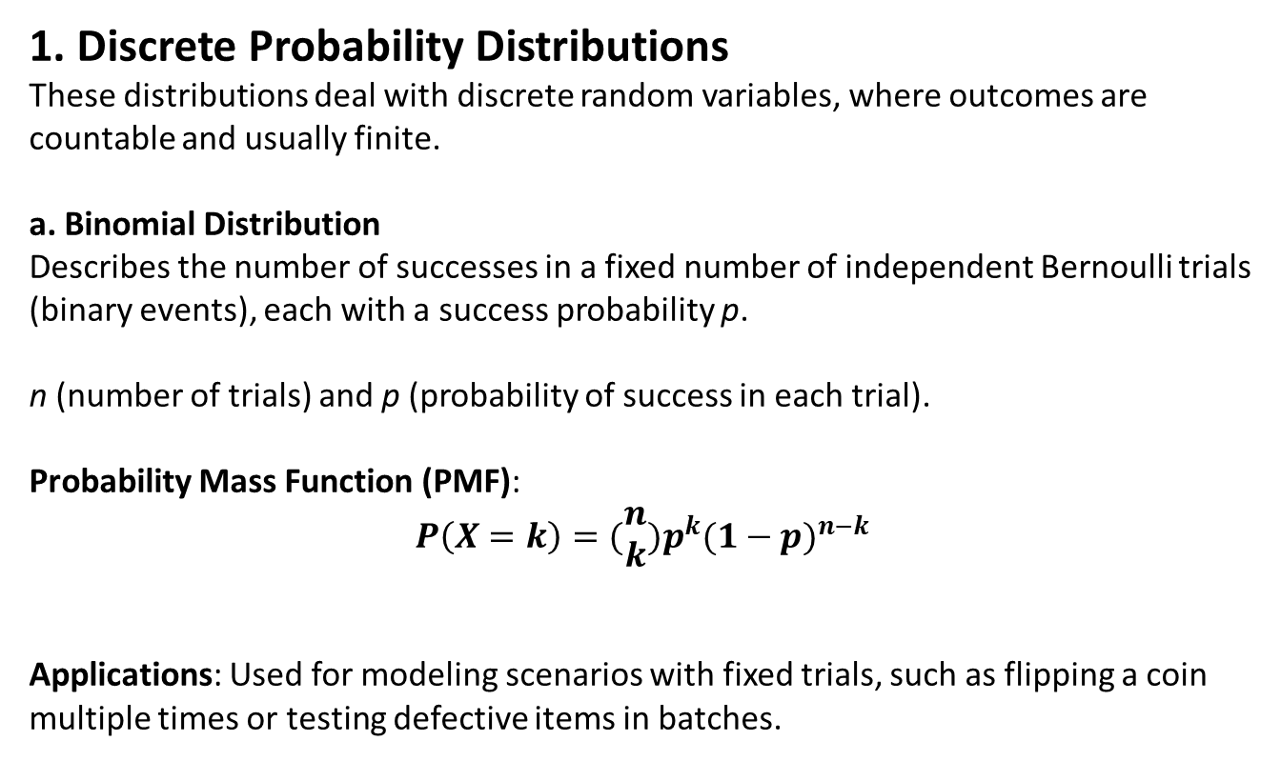
1. Discrete Probability Distributions
These distributions deal with discrete random variables, where outcomes are countable and usually finite.
a. Binomial Distribution
Describes the number of successes in a fixed number of independent Bernoulli trials (binary events), each with a success probability p.
n (number of trials) and p (probability of success in each trial).
Probability Mass Function (PMF):
$$P\left(X=k\right)=(\begin{matrix}n \\ k\end{matrix})p^{k}{(1−p)}^{n−k}$$
Applications: Used for modeling scenarios with fixed trials, such as flipping a coin multiple times or testing defective items in batches.

Slide 4
Example: Quality Control in Manufacturing
Suppose a manufacturing company produces electronic components, and each component has a probability p of being defective. Let's say quality engineers are interested in testing a batch of 100 components to determine if they meet quality standards, where the probability of a component being defective is p=0.02 (or 2%).
How the Binomial Distribution Applies
Defining Success and Failure:
"Success" could be defined as finding a defective component.
"Failure" is finding a non-defective component.
Parameters:
The number of trials, n, is the sample size of 100 components.
The probability of finding a defective component, p, is 0.02.
Binomial Distribution:
This setup follows a binomial distribution Binomial (n=100,p=0.02)
Engineers can use the distribution to calculate the probability of finding a certain number of defective components in the sample.

Slide 5



Example Calculations
Probability of finding exactly 5 defective components:
Probability of finding at least 1 defective component:
where P(X=0)=(0.98)¹⁰⁰, since P(X=0) represents the probability that all components are non-defective.
3D Calculator - GeoGebra

Slide 6
Interpretation and Usage
If the probability of finding a high number of defective components is significant, it may indicate a quality issue with the production process, prompting further investigation.
Engineers can use this probability to set quality control thresholds. For example, if finding more than a certain number of defective items in a sample is unlikely (e.g., less than a 5% chance), they may flag the batch for inspection if that threshold is exceeded.
The binomial distribution in this case provides a quantitative approach to assess the quality level and consistency of the manufacturing process, allowing engineers to make informed decisions on batch acceptance or rejection based on statistically sound probabilities.

Slide 7
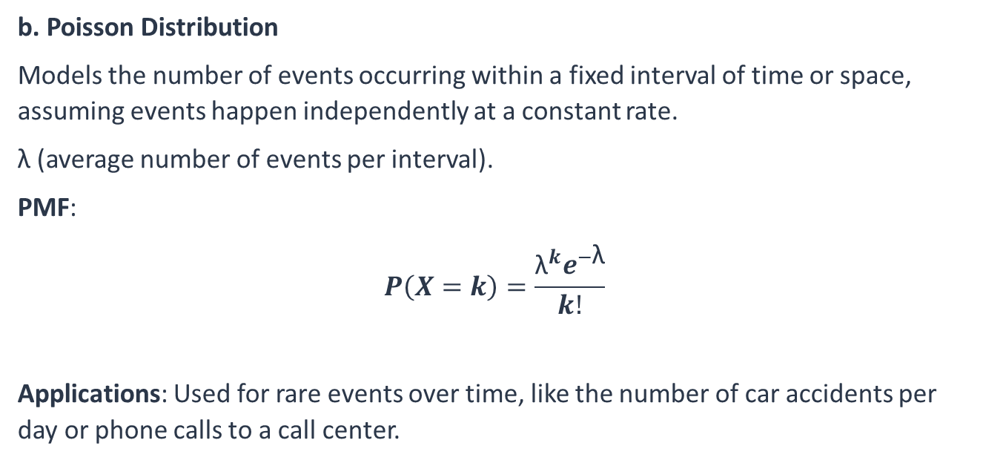
b. Poisson Distribution
Models the number of events occurring within a fixed interval of time or space, assuming events happen independently at a constant rate.
λ (average number of events per interval).
PMF:
$$P\left(X=k\right)=\frac{{\text{λ}}^{k}e^{−\text{λ}}}{k!}$$
Applications: Used for rare events over time, like the number of car accidents per day or phone calls to a call center.

Slide 8
Example: Modeling Equipment Failures in a Factory
Suppose a factory operates a large number of machines, and historically, breakdowns occur at an average rate of 3 failures per day across all machines. The engineering team wants to model the probability of observing a certain number of machine failures in a day to plan maintenance resources effectively.
How the Poisson Distribution Applies
Defining the Event:
The "event" of interest is a machine failure.
Each machine failure is rare and independent of the others, and they happen randomly over time.
Parameter:
The average rate of failure λ is 3 failures per day.
Poisson Distribution:
This scenario follows a Poisson distribution with λ=3.
It is possible can calculate the probability of observing a specific number of failures (e.g., 0, 1, 2, etc.) in a given day.

Slide 9


Probability of observing exactly 5 machine failures in a day:
This tells us that there’s about a 10% chance of seeing exactly 5 failures in a day.
Probability of observing no failures in a day:
This indicates about a 5% chance of no failures, which could inform the engineers on how often to expect uninterrupted operation.

Slide 10
Interpretation and Usage
If the probability of a high number of failures (e.g., 7 or more) is relatively low, engineers may decide that minimal backup equipment or staff will suffice for most days.
On days with a high predicted probability of multiple failures (such as 3 or more), additional resources could be scheduled in advance.
Using the Poisson distribution allows the factory’s engineering team to anticipate typical failure rates and manage resources efficiently for maintenance, minimizing downtime and keeping operations running smoothly.

Slide 11
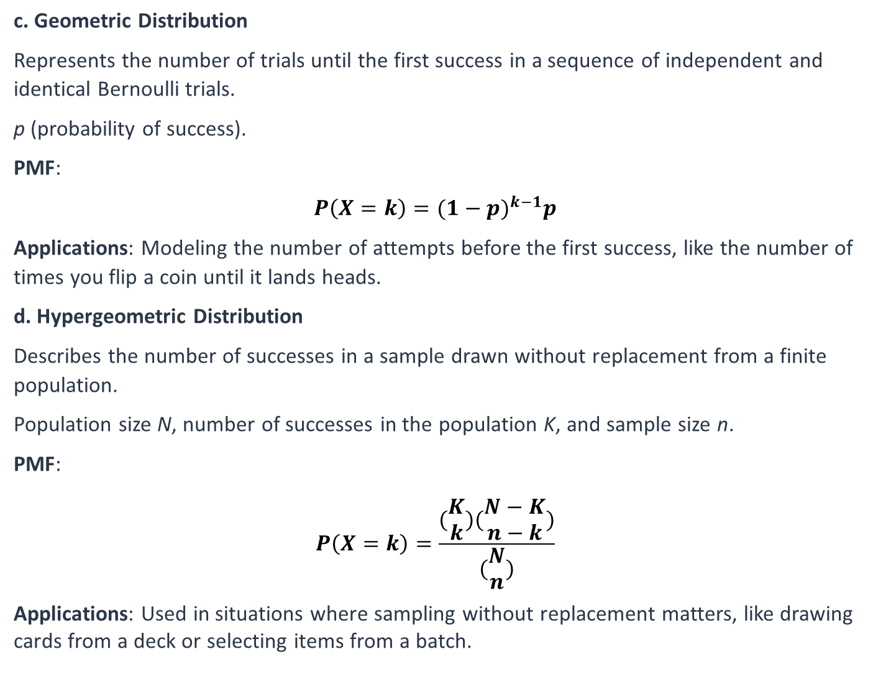
c. Geometric Distribution
Represents the number of trials until the first success in a sequence of independent and identical Bernoulli trials.
p (probability of success).
PMF:
$$P\left(X=k\right)=(1−{p)}^{k−1}p$$
Applications: Modeling the number of attempts before the first success, like the number of times you flip a coin until it lands heads.
d. Hypergeometric Distribution
Describes the number of successes in a sample drawn without replacement from a finite population.
Population size N, number of successes in the population K, and sample size n.
PMF:
$$P\left(X=k\right)=\frac{(\begin{matrix}K \\ k\end{matrix})(\begin{matrix}N−K \\ n−k\end{matrix})}{(\begin{matrix}N \\ n\end{matrix})}$$
Applications: Used in situations where sampling without replacement matters, like drawing cards from a deck or selecting items from a batch.

Slide 12
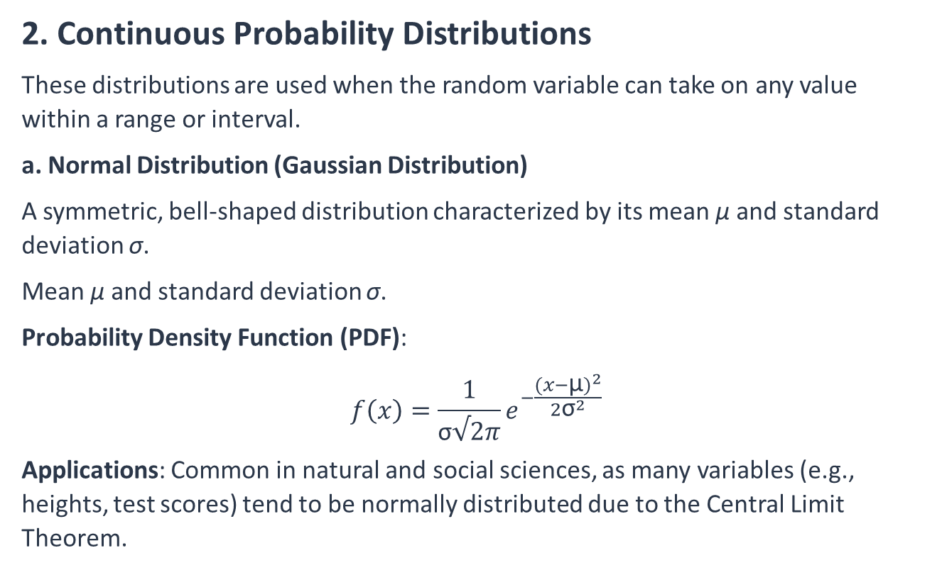
2. Continuous Probability Distributions
These distributions are used when the random variable can take on any value within a range or interval.
a. Normal Distribution (Gaussian Distribution)
A symmetric, bell-shaped distribution characterized by its mean μ and standard deviation σ.
Mean μ and standard deviation σ.
Probability Density Function (PDF):
$$f\left(x\right)=\frac{1}{\text{σ}√2π}e^{−\frac{{(x−\text{μ})}^{2}}{{2\text{σ}}^{2}}}$$
Applications: Common in natural and social sciences, as many variables (e.g., heights, test scores) tend to be normally distributed due to the Central Limit Theorem.

Slide 13
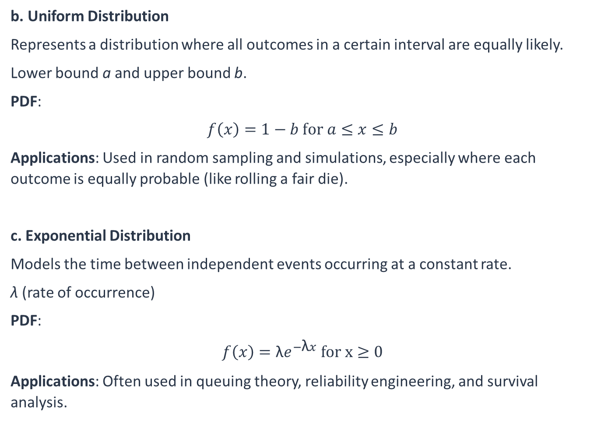
b. Uniform Distribution
Represents a distribution where all outcomes in a certain interval are equally likely.
Lower bound a and upper bound b.
PDF:
$$f\left(x\right)=1−b for a≤x≤b$$
Applications: Used in random sampling and simulations, especially where each outcome is equally probable (like rolling a fair die).
c. Exponential Distribution
Models the time between independent events occurring at a constant rate.
λ (rate of occurrence)
PDF:
$$f\left(x\right)=\text{λ}e^{−\text{λ}x} for x≥0$$
Applications: Often used in queuing theory, reliability engineering, and survival analysis.

Slide 14
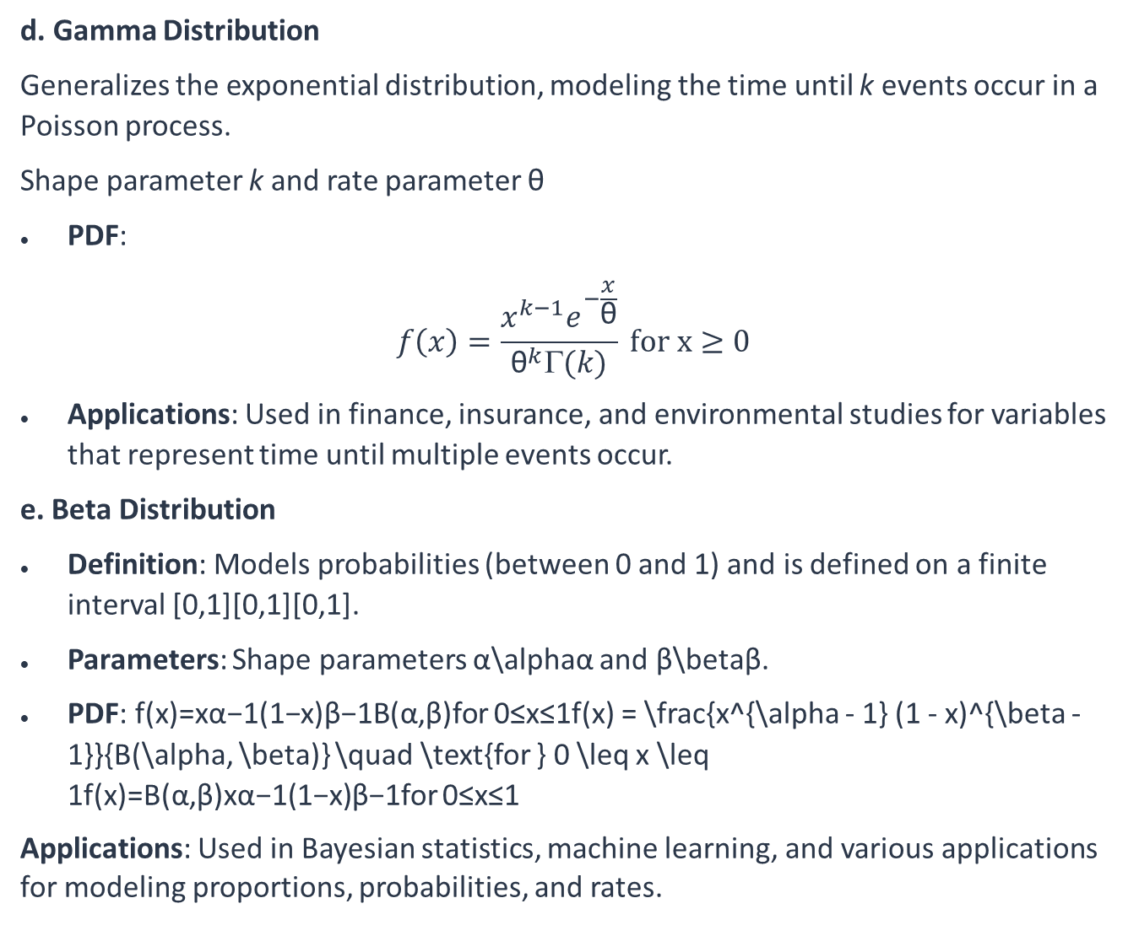
d. Gamma Distribution
Generalizes the exponential distribution, modeling the time until k events occur in a Poisson process.
Shape parameter k and rate parameter θ
PDF:
$$f\left(x\right)=\frac{x^{k−1}e^{−\frac{x}{\text{θ}}}}{{\text{θ}}^{k}Γ(k)} for x≥0$$
Applications: Used in finance, insurance, and environmental studies for variables that represent time until multiple events occur.
e. Beta Distribution
Definition: Models probabilities (between 0 and 1) and is defined on a finite interval [0,1][0,1][0,1].
Parameters: Shape parameters α\alphaα and β\betaβ.
PDF: f(x)=xα−1(1−x)β−1B(α,β)for 0≤x≤1f(x) = \frac{x^{\alpha - 1} (1 - x)^{\beta - 1}}{B(\alpha, \beta)} \quad \text{for } 0 \leq x \leq 1f(x)=B(α,β)xα−1(1−x)β−1​for 0≤x≤1
Applications: Used in Bayesian statistics, machine learning, and various applications for modeling proportions, probabilities, and rates.

Slide 15
Weibull distribution
The Weibull distribution is a versatile continuous probability distribution used widely in reliability analysis, survival analysis, and modeling lifetimes of products or time-to-failure data. Its flexibility allows it to model various types of failure rates, which makes it valuable in fields like engineering, medicine, and risk management.
Definition and Parameters
The Weibull distribution has two primary parameters:
Shape parameter (k): Determines the shape of the distribution. It is often referred to as the Weibull slope. Different values of k result in different behaviors of the distribution.
Scale parameter (λ): Determines the scale or spread of the distribution. This is a measure of the distribution’s scale and is analogous to the mean or median in some cases.

Slide 16



Probability Density Function (PDF) for a variable X with shape k and scale λ is defined as:
Key Properties
Mean: The mean E(X) of a Weibull-distributed variable is given by:
where Γ is the gamma function.
Variance: The variance Var(X) is:

Slide 17
Interpreting the Shape Parameter k
The shape parameter k significantly impacts the form of the Weibull distribution:
k<1: Indicates a decreasing failure rate. This scenario is typical in infant mortality cases or products with an initial high failure rate that decreases over time as defective units fail early.
k=1: Reduces the Weibull distribution to an exponential distribution, implying a constant failure rate. This is common in memoryless processes, where the failure rate remains constant over time.
k>1: Implies an increasing failure rate, which is typical in aging products where the likelihood of failure increases with time.

Slide 18
Applications of the Weibull Distribution
The Weibull distribution's flexibility makes it useful across various domains, especially in the analysis of time-to-failure data. Some notable applications include:
Reliability Engineering and Failure Analysis: Used to model the lifespan of mechanical and electronic components. Engineers use it to predict product failure times and design maintenance schedules.
Survival Analysis: In medical research, the Weibull distribution models time until an event, such as death or relapse, allowing researchers to understand disease progression.
Wind Speed Modeling: The Weibull distribution models wind speeds and helps predict power generation from wind turbines.
Risk and Insurance: Insurers use the Weibull distribution to assess the risk of large claims based on the likelihood and timing of extreme losses.

Slide 19
Example: Predicting Time to Failure for Machine Components
Suppose an engineering team at a manufacturing plant wants to predict the failure times of a particular type of machine component (such as a bearing). Historical data shows that the time-to-failure distribution of these components follows a Weibull distribution, which allows them to understand and anticipate the different stages of the component's lifecycle.
How the Weibull Distribution Applies
Defining the Application:
The time until a component fails is the variable of interest.
The engineering team wants to determine the probability of failure within a certain time to optimize maintenance schedules and minimize unexpected downtimes.
Parameters:
Based on historical data, the components have a shape parameter k=1.5, which indicates an increasing failure rate over time (common for parts that wear out).
The scale parameter λ=1000 hours, meaning components typically last around 1000 hours.

Slide 20


Using the Weibull Distribution:
With k=1.5 and λ=1000, the Weibull distribution describes the failure probability over time.
Engineers can calculate the probability that a component will fail by a certain time, or conversely, the likelihood it will survive past that time.
Calculations
Probability of a component failing within the first 800 hours:
This calculation shows about a 32.9% chance that a component will fail within 800 hours of operation.
Expected Time by which 90% of components will have failed:
For time t when F(t)=0.9 to find the time by which 90% of components are expected to fail:
Solving this equation gives t≈1631 hours, meaning that 90% of components are expected to fail by around 1631 hours.

Slide 21
Interpretation and Usage
Preventive Maintenance Planning: If the goal is to perform preventive maintenance before a high probability of failure, the engineering team might plan to replace components around the 1000-hour mark or even sooner, reducing the chance of unexpected failures.
Resource Allocation: Understanding the expected time to failure can help in stocking replacement parts and scheduling maintenance personnel effectively.

Slide 22
Exponential distribution
The exponential distribution is a continuous probability distribution often used to model the time between independent events that occur at a constant average rate. It is especially useful in reliability engineering, queuing theory, and other areas where one needs to understand the timing of events.

Slide 23

Key Characteristics of the Exponential Distribution
Memoryless Property:
The exponential distribution has a unique property called memorylessness. This means that the probability of an event occurring in the future is independent of how much time has already passed. Mathematically, for any s and t≥0,
This property is why the exponential distribution is often used to model processes like equipment failures, where the likelihood of failure does not depend on the equipment's age.
2. Parameter λ:
The exponential distribution is defined by a rate parameter λ>0, which represents the average rate at which events occur. The mean (average time between events) is the reciprocal of λ​.
If events occur on average every 10 minutes, for example, λ=1/10=0.1 events per minute.

Slide 24


3. Probability Density Function (PDF):
The PDF of the exponential distribution for a random variable X is given by:
This describes the likelihood of the time between events being exactly x.
4. Cumulative Distribution Function (CDF):
The CDF, representing the probability that the time between events is less than or equal to x, is:
5. Mean and Variance:
Mean: The mean of the exponential distribution is 1/λ​, which is the expected time between events.
Variance: The variance is 1/λ².

Slide 25
Applications of the Exponential Distribution
Reliability Engineering:
The exponential distribution models the time until failure of equipment that has a constant failure rate, meaning the likelihood of failure does not increase over time. For example, light bulbs or electronic components with random failures often fit this model well.
2. Queuing Theory:
In queue systems (such as customer service or telecommunications), the exponential distribution models the time between arrivals of customers or calls, assuming a constant arrival rate.
3. Survival Analysis:
In biostatistics, the exponential distribution is used to model survival times, especially when the event rate (e.g., mortality rate) is constant over time.

Slide 26
Example Calculation
Suppose we have a system where failures occur on average every 5 hours. Here, λ=1/5=0.2 failures per hour.
Probability that the next failure occurs in less than 3 hours:
So, there is about a 45.1% chance that the next failure will occur within 3 hours.
The exponential distribution provides a straightforward way to model and analyze the timing of events that occur randomly and independently over time.

Slide 27
Example: Predicting Time Between Failures for Light Bulbs in a Factory
Suppose a factory uses hundreds of identical light bulbs to illuminate production areas. These bulbs are known to have a constant failure rate (i.e., they don’t degrade over time but rather fail randomly and independently). Engineers want to model the time between bulb failures to plan replacements efficiently and ensure that production areas are always well-lit.

Slide 28

How the Exponential Distribution Applies
Defining the Scenario:
The event of interest is a light bulb failure.
Failures happen randomly at a constant rate, regardless of how long a bulb has been in use, which is a characteristic scenario for an exponential distribution.
Parameter:
Based on historical data, the average time until a bulb fails is 5000 hours. The exponential distribution’s rate parameter λ is the reciprocal of the mean time to failure: λ=1/5000=0.0002 failures per hour
Using the Exponential Distribution:
This distribution, can be used to calculate probabilities related to the time between bulb failures.

Slide 29
Calculations
Probability that a bulb will last at least 6000 hours:
This shows there’s about a 30.1% chance that a light bulb will last 6000 hours or longer.
Expected Number of Failures in a Month: Assuming continuous operation (24 hours a day), the number of expected failures in 30 days (or 720 hours) can be calculated as:
Expected failures=λ×720=0.0002×720=0.144
This indicates that, on average, about 0.144 bulbs will fail in a month, which could inform the team how frequently to expect failures over longer periods.

Slide 30
Sampling
Sampling is a crucial technique in statistics that involves selecting a subset of data from a larger population to make inferences about the whole. Different sampling methods and considerations of sample size can impact the accuracy and reliability of these inferences.

Slide 31
Types of Sampling
A. Probability Sampling: Every member of the population has a known, non-zero probability of being selected. This type helps reduce selection bias and allows for generalization to the entire population.
Simple Random Sampling: Each member has an equal chance of being chosen. For example, drawing names from a hat.
Stratified Sampling: The population is divided into subgroups (strata) based on shared characteristics, and random samples are drawn from each stratum proportionally.
Systematic Sampling: Every kthk^{th}kth member of the population is chosen after selecting a random starting point. This is simpler than simple random sampling and effective when the list of the population is organized.
Cluster Sampling: The population is divided into clusters (often geographically), and entire clusters are randomly selected. Useful for large, spread-out populations, though variability within clusters should be low for accuracy.
Multi-Stage Sampling: Combines several probability sampling methods in stages, often used in complex or large populations.

Slide 32
B. Non-Probability Sampling: Members are selected in ways that do not give each individual in the population a known or equal chance of being chosen. While more convenient, non-probability sampling may introduce bias and limit generalization.
1. Convenience Sampling: Selection based on ease of access. For example, surveying people nearby. Quick and cost-effective but not necessarily representative.
2. Judgmental or Purposive Sampling: The researcher uses their judgment to select the sample based on specific criteria. Useful in exploratory studies or when a specific subset of the population is of interest.
3. Quota Sampling: Similar to stratified sampling but without random selection. Researchers gather data from predetermined quotas within specific subgroups.
4. Snowball Sampling: Initial subjects are selected, and they refer others, building the sample. Common in hard-to-reach populations, like specific social groups.

Slide 33
Sample Size
Choosing an appropriate sample size is essential to ensure accurate and reliable results. Factors influencing sample size include:
Population Size: The total number of subjects or units in the population. A smaller population might allow for a smaller sample, whereas a large population often requires a larger sample.
Margin of Error (MoE): The desired precision of the estimate, usually expressed as a percentage. A smaller MoE requires a larger sample size to improve accuracy.
Confidence Level: The degree of certainty that the true population parameter lies within the margin of error around the sample estimate. Common confidence levels are 90%, 95%, and 99%. Higher confidence levels require larger sample sizes.
Population Variability: The degree to which subjects in the population differ from each other. Higher variability necessitates a larger sample size to capture the diversity accurately.
Study Design and Goals: Complex designs or comparisons between groups typically require larger samples.

Slide 34

Sample Size Calculation
For simple random sampling with a proportion estimate, the required sample size n can be calculated using:
​where:
Z is the Z-score corresponding to the desired confidence level,
p is the estimated proportion (often set at 0.5 when unknown for maximum variability),
E is the margin of error.

Slide 35

Example:
Suppose a researcher wants a 95% confidence level (Z = 1.96) with a 5% margin of error for a survey where they expect the population proportion to be approximately 0.4.
Thus, a sample size of approximately 369 would be needed to meet the criteria.

Slide 36
Sample tests
Sample tests, also known as hypothesis tests, are statistical methods used to make inferences about a population based on a sample. These tests help determine if observed data significantly differ from expected outcomes or population parameters. Sample tests are crucial in research, quality control, and decision-making processes.

Slide 37
Types of Sample Tests
Z-Test
Used when the population variance is known, or the sample size is large (typically n>30).
Assumes a normally distributed population.
Common types:
One-Sample Z-Test: Tests if a sample mean differs from a known population mean.
Two-Sample Z-Test: Compares the means of two independent samples to see if they differ significantly.

Slide 38
T-Test
Used when the population variance is unknown, and the sample size is small (n≤30).
Assumes normally distributed data, though it's robust to small deviations.
Types:
One-Sample T-Test: Tests if the sample mean differs from a known population mean.
Independent (Two-Sample) T-Test: Compares the means of two independent groups to check for significant differences.
Paired T-Test: Compares means from two related groups, such as before-and-after measurements on the same subjects.

Slide 39
One-Sample T-Test
Purpose: Tests whether the mean of a single sample differs from a known or hypothesized population mean.
Example: Determining if the average weight of a sample of apples differs from a hypothesized average weight of 150 grams.
Hypotheses:
Null Hypothesis (H₀​): The sample mean is equal to the population mean.
Alternative Hypothesis (H_{a}​): The sample mean is different from the population mean.

Slide 40
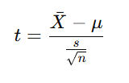
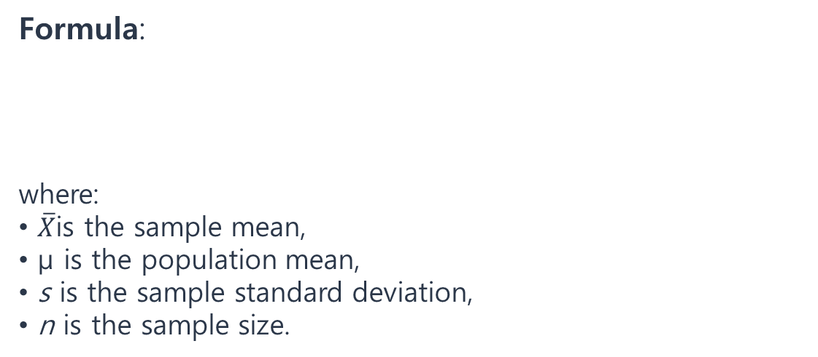
Formula:
where:
$\overline{X}$is the sample mean,
μ is the population mean,
s is the sample standard deviation,
n is the sample size.

Slide 41
Independent (Two-Sample) T-Test
Purpose: Tests whether the means of two independent groups differ significantly.
Example: Comparing the average test scores of two different teaching methods.
Hypotheses:
Null Hypothesis (H₀​): The means of the two groups are equal.
Alternative Hypothesis (H_{a}​): The means of the two groups are different.
Assumptions:
Samples are independent of each other.
Data should ideally be normally distributed.
Variances in the two groups are assumed to be equal (if not, a version known as Welch’s T-test is used).

Slide 42
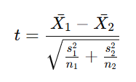
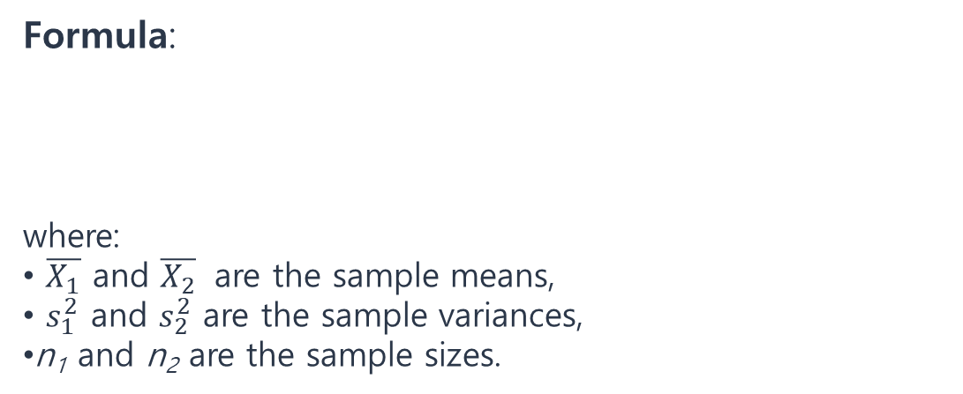
Formula:
​​where:
$\overline{X_{1}}$ and $\overline{X_{2}}$ are the sample means,
$s_{1}^{2}$​ and $s_{2}^{2}$​ are the sample variances,
n₁​ and n₂​ are the sample sizes.

Slide 43
Paired (Dependent) T-Test
Purpose: Tests whether the means of two related groups differ significantly.
Example: Comparing pre-test and post-test scores of the same participants to assess the impact of an intervention.
Hypotheses:
Null Hypothesis (H₀​): The mean difference between paired observations is zero.
Alternative Hypothesis (H_{a}​): The mean difference between paired observations is not zero.
Assumptions:
Data pairs are independent of other pairs.
The differences between pairs should be approximately normally distributed.

Slide 44

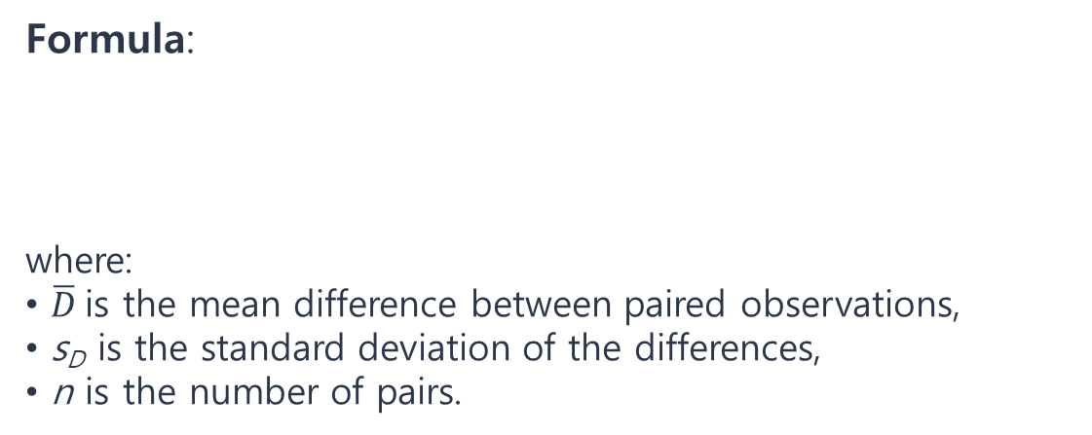
Formula:
where:
$\overline{D}$is the mean difference between paired observations,
s_{D}​ is the standard deviation of the differences,
n is the number of pairs.

Slide 45
Steps in Conducting a T-Test
State the Hypotheses:
Define the null (H₀​) and alternative (H_{a}​) hypotheses.
Choose the Significance Level (α):
Typically set to 0.05 or 0.01.
Calculate the T-Statistic:
Use the appropriate formula for the type of T-test being conducted.
Determine the Critical Value or p-Value:
Compare the calculated t-statistic to the critical t-value from the t-distribution table based on degrees of freedom.
Alternatively, calculate the p-value.
Make a Decision:
If the t-statistic exceeds the critical value (or the p-value is less than α), reject H₀​; otherwise, do not reject H₀​.
Interpret the Result:
Explain the findings in the context of the research question.

Slide 46

Example of an Independent T-Test
Suppose a researcher wants to test if two different diets lead to different average weight losses. Group A (Diet A) and Group B (Diet B) have weight loss data for 30 people each.
Hypotheses:
(no difference in average weight loss).
(a difference in average weight loss).
Calculation:
Calculate the mean and standard deviation for each group, compute the T-statistic, and compare it to the critical value or determine the p-value.
A significant result would suggest a difference in effectiveness between the two diets.
The T-test is a valuable tool for comparing group means, and its simplicity makes it widely applicable in various fields, from biology to business and beyond.

Slide 47
Chi-Square ( χ2) Test
Used for categorical data to test relationships or goodness-of-fit.
Types:
Chi-Square Goodness-of-Fit Test: Tests if observed frequencies match expected frequencies for one categorical variable.
Chi-Square Test of Independence: Tests if there is an association between two categorical variables.

Slide 48
Chi-Square Test of Independence
Purpose: To test whether there is an association between two categorical variables.
Example: Determining if there is an association between gender (male/female) and preference for a product (yes/no).
Hypotheses:
Null Hypothesis (H₀​): There is no association between the two variables (they are independent).
Alternative Hypothesis (H_{a}​): There is an association between the two variables (they are not independent).

Slide 49
Chi-Square Goodness-of-Fit Test
Purpose: To test if the observed frequencies for a single categorical variable match expected frequencies.
Example: Testing if the observed distribution of eye colors in a sample of students fits the expected distribution.
Hypotheses:
Null Hypothesis (H₀​): The observed distribution matches the expected distribution.
Alternative Hypothesis (H_{a}​): The observed distribution does not match the expected distribution.

Slide 50


Formulas and Calculations
Chi-Square Test Statistic:
For both the Test of Independence and the Goodness-of-Fit Test, the Chi-Square statistic (χ2) is calculated as:
where:
O_{i}​ is the observed frequency for category i,
E_{i}​ is the expected frequency for category i.
2. Degrees of Freedom (df):
For the Test of Independence:
where r is the number of rows, and c is the number of columns in a contingency table.
For the Goodness-of-Fit Test:
where k is the number of categories.

Slide 51
Steps in Conducting a Chi-Square Test
State the Hypotheses:
Define the null (H₀​) and alternative (H_{a}​) hypotheses.
Set the Significance Level (α):
Typically 0.05 or 0.01.
Create a Contingency Table (for Test of Independence):
For each combination of categories, count the frequencies and calculate the expected counts.
Calculate the Chi-Square Statistic:
Use the formula to find χ2 based on observed and expected counts.
Determine the Critical Value or p-Value:
Compare the calculated χ2-statistic to the critical value from the Chi-Square distribution table for the given degrees of freedom or calculate the p-value.
Make a Decision:
If χ2 is greater than the critical value (or the p-value is less than α), reject H₀​; otherwise, do not reject H₀.
Interpret the Result:
Describe the findings in the context of the research question.

Slide 52
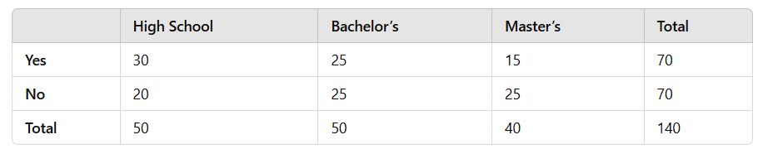

Example of Chi-Square Test of Independence
Suppose a researcher wants to know if there is an association between education level (High School, Bachelor’s, Master’s) and preference for a product (Yes, No). The data is collected and arranged in a contingency table:
Calculate Expected Counts for each cell under the assumption that the variables are independent. For example, the expected count for "Yes" and "High School" would be:
Calculate the Chi-Square Statistic by comparing observed and expected counts for each cell in the table.
Degrees of Freedom: df=(2−1)(3−1)=2
Compare with Critical Value or calculate the p-value to conclude if there is a significant association.

Slide 53

Example of Chi-Square Goodness-of-Fit Test
Suppose a die is rolled 60 times with the following observed outcomes:
If the die is fair, each outcome is expected to appear
E=60/6=10 times.
Calculate Chi-Square Statistic based on the formula with each observed count versus the expected count of 10.
Degrees of Freedom:
df=6−1=5
Compare with Critical Value to test if the observed distribution significantly differs from a uniform (equal) distribution.

Slide 54
ANOVA (Analysis of Variance)
Analysis of Variance (ANOVA) is a statistical technique used to determine if there are statistically significant differences among the means of three or more groups. It is particularly useful for comparing multiple groups and understanding whether variation in data is due to different treatment effects or simply due to random variation. ANOVA relies on F-tests to compare the variances between groups and within groups.
Types of ANOVA
One-Way ANOVA
Purpose: Tests if there are significant differences among the means of three or more independent (unrelated) groups.
Example: Comparing the average test scores among students who studied under three different teaching methods.
Hypotheses:
Null Hypothesis (𝐻₀): All group means are equal.
Alternative Hypothesis (𝐻𝑎): At least one group mean is different.

Slide 55
Two-Way ANOVA
Purpose: Tests for significant differences in means based on two independent factors, and can also test for an interaction effect between the factors.
Example: Examining the effect of fertilizer type and watering frequency on plant growth.
Hypotheses:
Tests three hypotheses:
Main effect of Factor A (e.g., fertilizer type).
Main effect of Factor B (e.g., watering frequency).
Interaction effect between Factors A and B.
Repeated Measures ANOVA
Purpose: Used when the same subjects are measured multiple times under different conditions (i.e., paired or dependent groups).
Example: Testing the effect of a new drug on blood pressure over several time points for the same participants.

Slide 56
F-test
The F-test is a statistical test used to compare the variances of two populations or to test the overall significance in analysis of variance (ANOVA). It is primarily applied in situations where researchers are interested in examining if there are differences in variability between groups or testing if multiple group means are equal in an ANOVA.

Slide 57

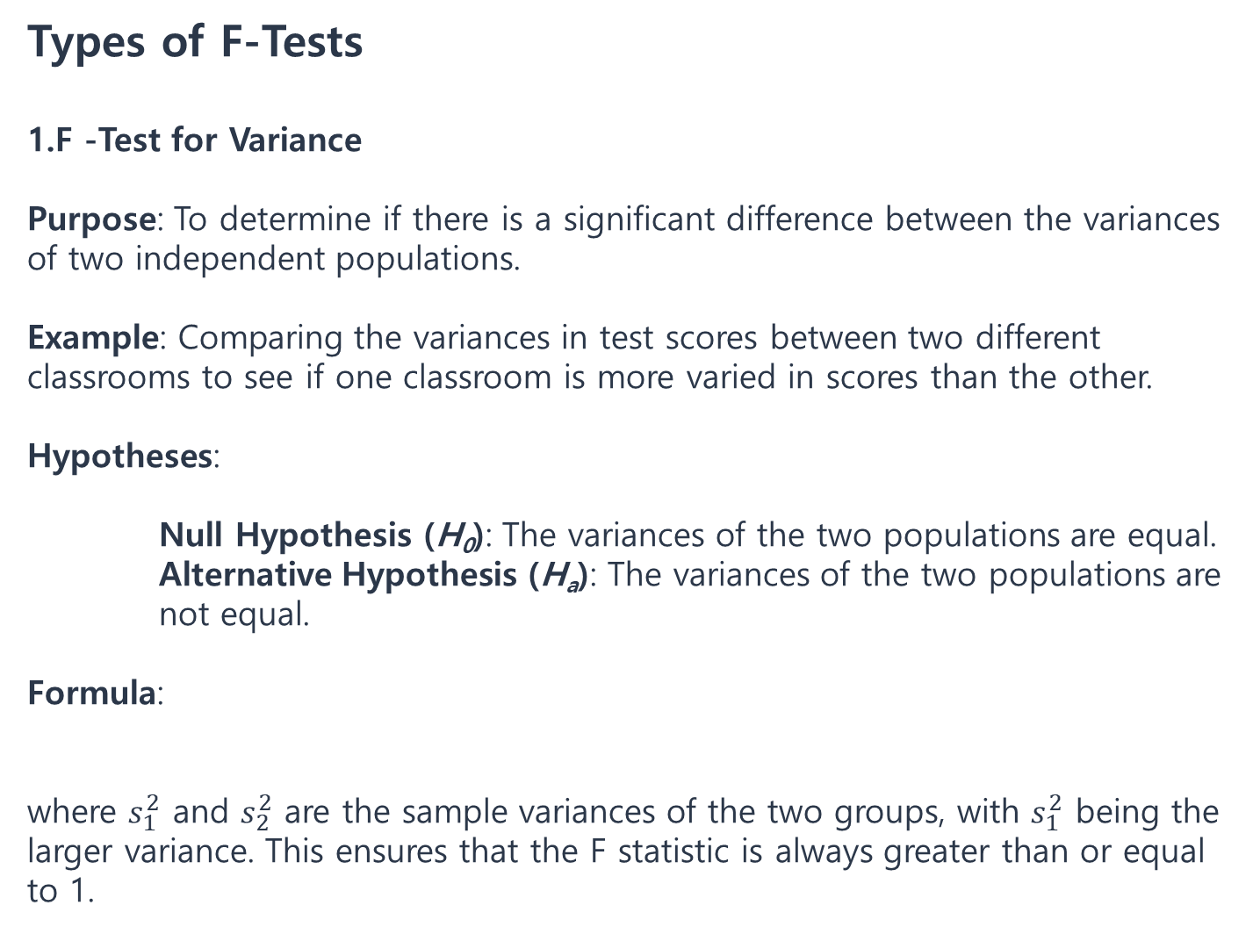
Types of F-Tests
F -Test for Variance
Purpose: To determine if there is a significant difference between the variances of two independent populations.
Example: Comparing the variances in test scores between two different classrooms to see if one classroom is more varied in scores than the other.
Hypotheses:
Null Hypothesis (H₀​): The variances of the two populations are equal.
Alternative Hypothesis (H_{a}​): The variances of the two populations are not equal.
Formula:
​​where $s_{1}^{2}$​ and $s_{2}^{2}$​ are the sample variances of the two groups, with $s_{1}^{2}$​ being the larger variance. This ensures that the F statistic is always greater than or equal to 1.

Slide 58

2. F-Test in Analysis of Variance (ANOVA)
Purpose: To test if there are significant differences among the means of three or more groups.
Example: Testing if different levels of fertilizer lead to different growth rates among plants.
Hypotheses:
Null Hypothesis (H₀​): All group means are equal.
Alternative Hypothesis (H_{a}​): At least one group mean is different.
Formula:
where:
Mean Square Between (MSB) measures the variance between the groups (explained variance).
Mean Square Within (MSW) measures the variance within each group (unexplained variance).

Slide 59
Key Components of the F-Test
Degrees of Freedom:
For the F-Test for Variance:
df₁=n₁−1, where n₁​ is the sample size of the first group.
df₂=n₂−1, where n₂​ is the sample size of the second group.
For ANOVA:
Between Groups: df_{b}=k−1, where k is the number of groups.
Within Groups: df_{w}=N−k, where N is the total number of observations across all groups.
F-Distribution:
The F-distribution is right-skewed and depends on two degrees of freedom: one for the numerator and one for the denominator.
An F-test is a one-tailed test since we only test if one variance is significantly larger than the other.

Slide 60
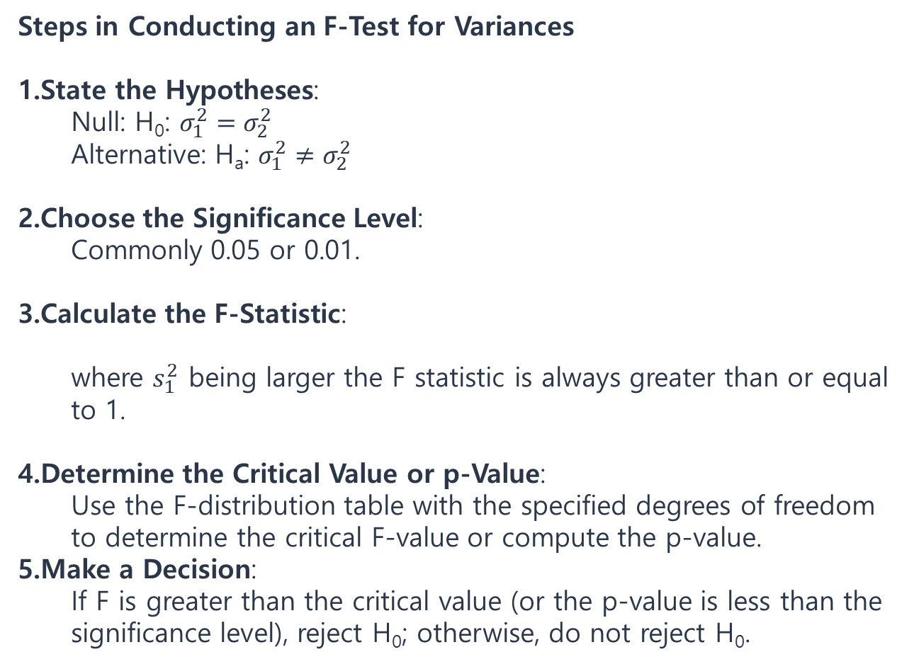
Steps in Conducting an F-Test for Variances
State the Hypotheses:
Null: H₀: $σ_{1}^{2}=σ_{2}^{2}$
Alternative: H_{a}: $σ_{1}^{2}≠σ_{2}^{2}$​
Choose the Significance Level:
Commonly 0.05 or 0.01.
Calculate the F-Statistic:
where $s_{1}^{2}$​ being larger the F statistic is always greater than or equal to 1.
Determine the Critical Value or p-Value:
Use the F-distribution table with the specified degrees of freedom to determine the critical F-value or compute the p-value.
Make a Decision:
If F is greater than the critical value (or the p-value is less than the significance level), reject H₀​; otherwise, do not reject H₀​.

Slide 61


Steps in Conducting an F-Test in ANOVA
State the Hypotheses:
Null: H₀: (all means are equal).
Alternative: H_{a}​: At least one mean differs.
Calculate the Sum of Squares and Mean Squares:
Total Sum of Squares (SST): Measures the total variance in the data.
Sum of Squares Between (SSB): Measures variance due to differences between group means.
Sum of Squares Within (SSW): Measures variance within each group.
Then calculate Mean Square Between (MSB) and Mean Square Within (MSW):
3.Calculate the F-Statistic:
Determine the Critical Value or p-Value: Use the F-distribution with the degrees of freedom for the numerator (df_{b}​) and denominator (df_{w}​).
Make a Decision: If F exceeds the critical value (or the p-value is less than the significance level), reject H₀​.

Slide 62
Example of F-Test in ANOVA
Suppose researchers want to test if three different fertilizers (A, B, C) lead to different plant growth rates. The data is collected, and the sum of squares and mean square values are calculated as follows:
SSB=60 with df_{b}=2, SSW=45 with df_{w}=12
Calculate the mean squares and F-statistic:
MSB=60/2=30, MSW=45/12=3.75, F=30/3.75​=8
Compare the F-statistic to the critical value for df_{b}=2 and df_{w}=12 or calculate the p-value to determine if there are significant differences among the fertilizer groups.

Slide 63
Examples of Sample Tests
Z-Test Example: Testing if a factory’s average production rate differs from the industry standard.
T-Test Example: Comparing pre- and post-training test scores of employees to see if training had a significant effect.
Chi-Square Test Example: Examining if customer preferences differ across age groups.
ANOVA Example: Testing if different fertilizers yield significantly different crop growth results.
Proportion Test Example: Testing if the proportion of defectives in a new batch differs from previous batches.
Choosing the Right Test
Data Type: Use a T-test or Z-test for means, Chi-Square for categorical data, and ANOVA for multiple groups.
Sample Size: T-tests are preferred for small samples; Z-tests are better for larger samples.
Assumptions: Use non-parametric tests if normality or equal variance assumptions are not met.

Slide 64
Model Verification
Verification is the process of determining if a model is implemented correctly according to its design and requirements. Verification answers the question, “Are we building the model correctly?”
Purpose: To ensure the model has been constructed and coded without errors and operates as intended based on the defined specifications. Primary focus is on model accuracy in terms of code, algorithms, and implementation.
Methods:
Code Review and Testing: Reviewing the model’s code for errors, debugging, and ensuring all functions operate correctly.
Algorithm Checks: Verifying that the algorithms used in the model are mathematically correct and implemented as intended.
Unit Testing and Component Testing: Testing individual parts or components of the model to make sure they function correctly.
Model Performance Testing: Ensuring that the model performs well computationally, is efficient, and is robust under various inputs.
Example
In a simulation model of a manufacturing process, verification would involve checking if the simulation code correctly implements the process logic, follows all steps correctly, and produces outputs without programming errors.

Slide 65
Model Validation
Validation is the process of evaluating if a model accurately represents the real-world system it is intended to simulate. Validation answers the question, “Are we building the right model?”
Purpose: To confirm that the model provides meaningful and accurate predictions or results for real-world applications. The focus is on the model's ability to represent reality and produce results consistent with observed data or expected behaviors.
Methods:
Comparison with Real Data: Comparing model outputs to real-world data to ensure they align closely.
Sensitivity Analysis: Testing how changes in model inputs affect outputs to ensure the model behaves realistically under various conditions.
Historical Data Testing: Using historical data to see if the model could have correctly predicted past outcomes.
Cross-Validation: Dividing the data into training and testing sets to evaluate if the model generalizes well to new data.
Expert Judgment and Face Validation: Having experts evaluate whether the model’s results appear realistic and accurate based on their experience.
Example
In the same manufacturing process simulation, validation would involve checking if the simulated production rates, resource utilization, and other outputs match actual production data, and if the model can predict performance under different scenarios accurately.

Slide 66
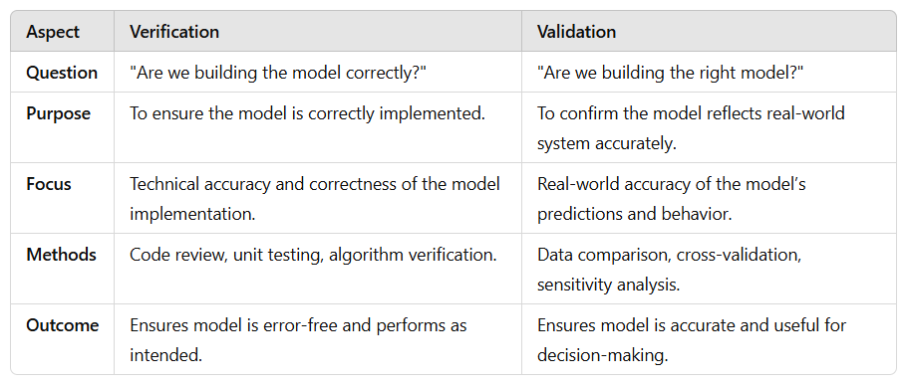
Key Differences Between Verification and Validation

Slide 67
Correlation analysis
Correlation analysis is a statistical method used to evaluate the strength and direction of the relationship between two or more variables. It helps in understanding whether, and how strongly, variables are related, which is essential in fields like research, data analysis, finance, engineering, and social sciences.

Slide 68
Types of Correlation
Positive Correlation: When two variables move in the same direction. As one variable increases, the other also increases, and as one decreases, the other also decreases.
Example: The relationship between temperature and ice cream sales — as temperature increases, ice cream sales typically increase.
Negative Correlation: When two variables move in opposite directions. As one variable increases, the other decreases.
Example: The relationship between the number of hours spent studying and the number of errors in a test — as study hours increase, the number of errors tends to decrease.
No Correlation: When there is no discernible pattern in the movement of two variables; changes in one do not affect the other in any systematic way.
Example: The relationship between shoe size and intelligence level in adults.

Slide 69

Types of Correlation Coefficients
Several methods can quantify correlation, with each method suited to specific types of data.
Pearson Correlation Coefficient (r)
Purpose: Measures the linear relationship between two continuous variables.
Value Range: -1 to +1
r=+1: Perfect positive linear relationship.
r=−1: Perfect negative linear relationship.
r=0: No linear relationship.
Assumptions: Both variables are normally distributed and have a linear relationship.
Formula:
Example: Examining the correlation between height and weight among adults.

Slide 70

Spearman’s Rank Correlation Coefficient (ρ)
Purpose: Measures the strength and direction of the monotonic relationship between two ranked variables.
Value Range: -1 to +1
Assumptions: Works with ordinal data or continuous data that do not meet Pearson’s normality assumptions.
Formula:
where d_{i}​ is the difference in ranks for each pair and n is the number of pairs.
Example: Analyzing the correlation between the ranks of students’ scores on two different tests.

Slide 71
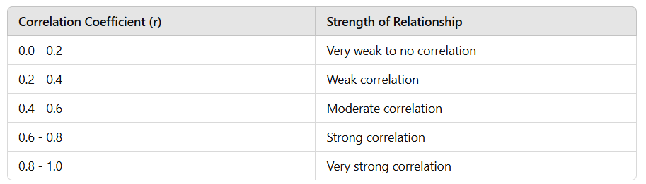
Interpreting Correlation Coefficients
These values can apply to both positive and negative correlations.

Slide 72
Limitations of Correlation Analysis
Does Not Imply Causation: A high correlation between two variables does not imply that one variable causes the other to change. There may be underlying factors or mere coincidence.
Sensitive to Outliers: Outliers can greatly affect the Pearson correlation, potentially masking or exaggerating the true relationship.
Only Measures Linear Relationships (for Pearson): Non-linear relationships are not captured by Pearson’s correlation.

Slide 73
Example of Correlation Analysis
Suppose a researcher is studying the relationship between hours of study (independent variable) and exam scores (dependent variable) among a group of students.
Data Collection: Gather data on hours of study and exam scores.
Choosing the Correlation Test:
If both variables are continuous and linearly related, use the Pearson correlation.
If the variables are ranked or do not meet normality assumptions, use Spearman’s correlation.
Calculation and Interpretation:
Calculate the correlation coefficient (e.g., Pearson’s r=0.75), indicating a strong positive correlation.
Interpret the result: Higher study hours are associated with higher exam scores, suggesting a positive association but not necessarily causation.

Slide 74
Factor Analysis
Factor Analysis is a statistical method used to identify underlying relationships between variables in a dataset. By reducing data dimensions, factor analysis helps in discovering patterns and grouping variables that share common underlying factors. This method is particularly useful in fields like psychology, finance, social sciences, and market research to simplify complex datasets and identify latent variables (factors) that explain the variance in observed variables.
Goals of Factor Analysis
Data Reduction: To condense a large set of variables into a smaller set of factors without losing significant information.
Identifying Latent Structures: To discover unobserved (latent) variables that explain the correlations among observed variables.

Slide 75
Key Concepts in Factor Analysis
Factors: Latent variables that represent the shared variance among observed variables.
Factor Loadings: Correlation coefficients between observed variables and factors.
Eigenvalues: Indicate the amount of variance captured by each factor; higher eigenvalues suggest stronger factors.
Communality: The proportion of each variable’s variance explained by the factors.
Uniqueness: The portion of variance in a variable that is unique to that variable and not shared with others.

Slide 76
Example of Factor Analysis
Suppose a survey is conducted to measure students’ satisfaction in different areas of university life, including academic support, social opportunities, campus facilities, and career services. Factor analysis could be used to:
Reduce the survey items into a few key factors, like “academic satisfaction,” “social satisfaction,” and “facility satisfaction.”
Identify groups of questions that load onto these factors, simplifying the data and making it easier to interpret and act upon.

Slide 77
Machine Learning
Machine learning (ML) is a subfield of artificial intelligence (AI) that focuses on using data and algorithms to enable machines to learn from experience and perform tasks without explicit programming.
It involves training algorithms on data sets to create models capable of predicting outcomes and classifying information autonomously.
•
Types of Learning
•
•
Supervised
Unsupervised

Slide 78
Unsupervised Learning
The model is not provided with the correct results during the training.
Can be used to cluster the input data in classes on the basis of their statistical properties only.
Cluster signiﬁcance and labeling.
The labeling can be carried out even if the labels are only available for a small number of objects representative of the desired classes.
•
•
•
•

Slide 79
Supervised Learning
Training data includes both the input and the desired results.
For some examples the correct results (targets) are
known and are given in input to the model during
the learning process.
The construction of a proper training, validation and test set is crucial.
These methods are usually fast and accurate.
Have to be able to generalize: give the correct
results when new data are given in input without
knowing a priori the target.
•
•
•
•
•

Slide 80
Regression Analysis
Regression is a predictive modeling technique used to estimate the relationship between a dependent (target) variable and one or more independent (predictor) variables. It is typically used when the target variable is continuous. The goal is to create a model that can make accurate predictions of the target variable based on the input predictors.
Types of Regression
Linear Regression:
Purpose: To model the relationship between a dependent variable and one or more independent variables linearly.
Example: Predicting house prices based on features like area, location, and number of rooms.
Formula:
where y is the predicted outcome, x_{i}​ are the predictors, β_{i}​ are the coefficients, and ϵ is the error term.

Slide 81

2. Logistic Regression:
Purpose: Used when the dependent variable is binary (e.g., 0 or 1, yes or no).
Example: Predicting whether a student will pass or fail an exam based on hours studied.
Formula (logistic function):
where p is the probability of the event occurring.
3. Polynomial Regression:
Purpose: Fits a polynomial equation to model non-linear relationships between the dependent and independent variables.
Example: Modeling the trajectory of a ball in physics experiments.
4. Multiple Regression:
Purpose: Extends linear regression to include multiple predictor variables.
Example: Predicting sales revenue based on advertising spend across multiple media platforms.

Slide 82
Classification Analysis
Classification is a technique in supervised learning where the objective is to categorize data into predefined classes or groups based on input features. The target variable is categorical (e.g., labels such as “spam” or “not spam”).
Types of Classification Algorithms
Logistic Regression (also used for binary classification, as noted above).
Decision Trees:
Purpose: Use a tree-like structure to make decisions based on feature values.
Example: Classifying loan applicants as “approved” or “rejected” based on credit score, income, etc.

Slide 83
3. k-Nearest Neighbors (k-NN):
Purpose: Classifies a new data point based on the majority class among its k-nearest neighbors.
Example: Classifying a type of flower based on petal and sepal measurements.
4. Support Vector Machines (SVM):
Purpose: Finds the optimal hyperplane that maximizes the margin between classes.
Example: Classifying emails as spam or not spam based on content.
5. Naive Bayes:
Purpose: Uses Bayes' theorem, assuming independence between features, to classify data.
Example: Text classification, such as categorizing news articles by topic.

Slide 84
Cluster Analysis
Clustering is an unsupervised learning technique used to group data into clusters or segments based on similarities among features. Unlike classification, clustering doesn’t require predefined labels, and the goal is to discover inherent groupings in the data.
Types of Clustering Algorithms
k-Means Clustering:
Purpose: Partitions data into k clusters by minimizing the distance between data points and the cluster centroids.
Example: Segmenting customers into groups based on purchasing behavior.
Hierarchical Clustering:
Purpose: Builds a hierarchy of clusters using either a bottom-up (agglomerative) or top-down (divisive) approach.
Example: Organizing documents based on content similarity into topic clusters.

Slide 85
3. DBSCAN (Density-Based Spatial Clustering of Applications with Noise):
Purpose: Groups points that are close in density, allowing for clusters of arbitrary shape and handling noise points.
Example: Identifying geographical regions with high crime rates.
4. Gaussian Mixture Models (GMM):
Purpose: Models data as a mixture of several Gaussian distributions to handle clusters that may overlap.
Example: Grouping genetic data where clusters have overlapping features.

Slide 86
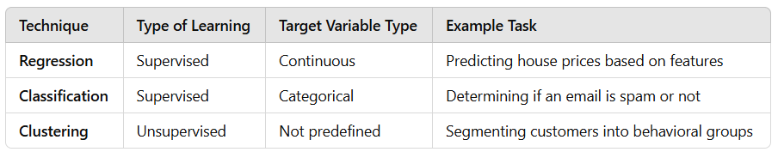
Comparing Regression, Classification, and Clustering

Slide 87
Case studies:
Application of machine learning

